Slide 1
NFL Super Bowl Study Group 4
May 11, 2020
Luis Cerrilla
John Dilligard
Will Pumphrey
Cale Wallace

Slide 2
Appendix
Conclusions
Dataset limitations
Possible tables and/or graphs
Problem Statement
Description of Data

Slide 3
Problem Statement
This is an analysis of a dataset of the history of Superbowl's, that is available on kaggle.com. The major purpose of this project is to answer some questions that our team has about the Superbowl’s, such as:
How many points do you need to win a Super Bowl?
Who is the player with the most MVPs?
Which teams have won the most Super Bowls?
How many points the winners scored?
What was the margins of victory over the years?
Where have the Super Bowls been held?

Slide 4
Description of Data
When looking for a good data set, we needed at data set that was complete, easy to access, and well documented.
The dataset is very clear and straightforward, it shows statistics for each Superbowl throughout the years. This data is enough for us to be able to answer our questions and finalize with our conclusions.
Transformation of Data
The data set had the date and it was changed to date time. Also the stadium locations were given without geolocational coordinates and we change Super Bowl numbers from roman numerals to regular numbers. We created Margin of Victory column in the data set

Slide 5
Description of Data
When looking for a good data set, we needed at data set that was complete, easy to access, and well documented.
The dataset is very clear and straightforward, it shows statistics for each Superbowl throughout the years. This data is enough for us to be able to answer our questions and finalize with our conclusions.
Transformation of Data
The data set had the date and it was changed to date time. Also the stadium locations were given without geolocational coordinates and we change Super Bowl numbers from roman numerals to regular numbers. We created Margin of Victory column in the data set

Slide 6
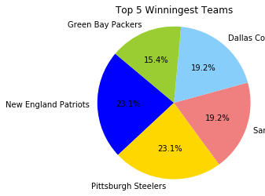
Conclusions
New England Patriots and Pittsburg Stealers are the teams with more Superbowl’s Championships with six each one.

Slide 7
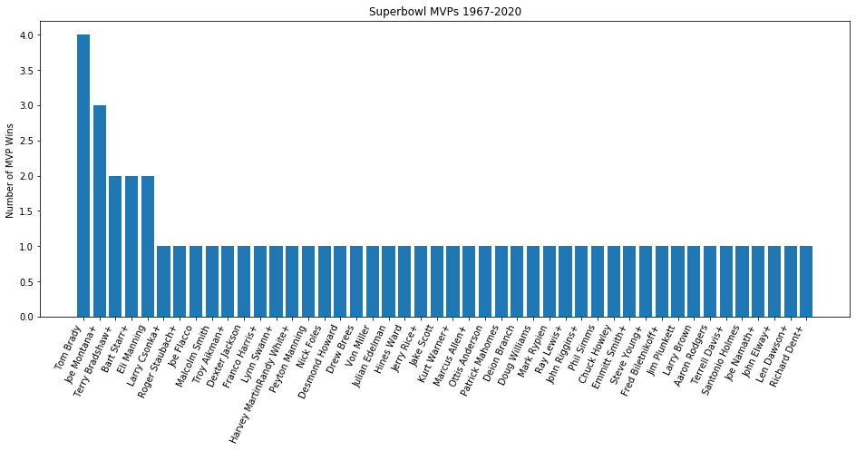
Conclusions
Tom Brady has been the player with most MVPs

Slide 8
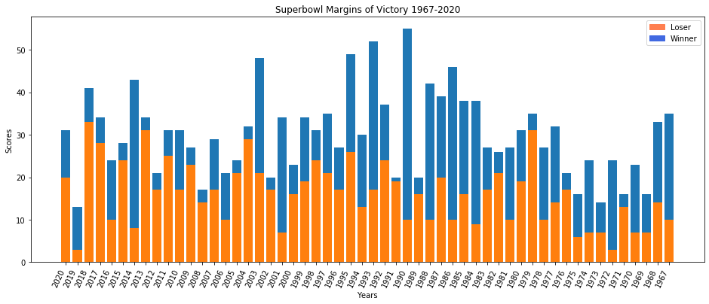
Conclusions
The margins of Superbowl's has increase over the years

Slide 9
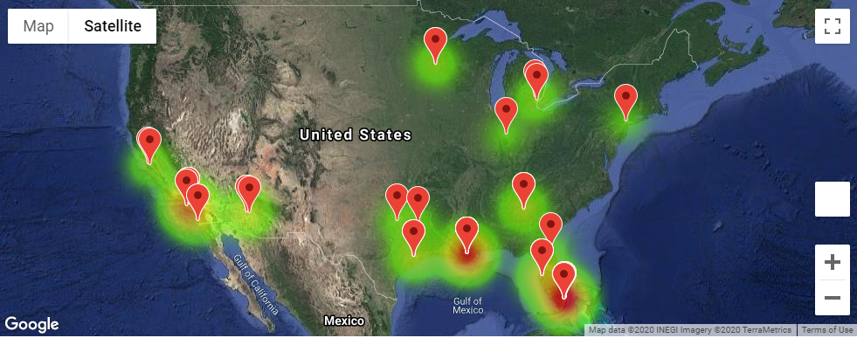
Conclusions
Mimi is the city with more Superbowl’s, and most of them have been on the south of the country.

Slide 10
#How many points do you need to win a Super Bowl?
#How many points the winners scored?

Slide 11
Limitations
The dataset was very limited, it only contains the basic information about Superbowl’s. We consider we could make a deeper analysis with more statistics.
53 rows, one for each Superbowl
10 columns of data/statistics

Slide 12
Possible tables and/or graphs
We could have made beans for different time periods and compare how Superbowl's have change threw the years.

